Slide 1
Therapeutics for Emerging Viruses
Dr. Timothy Sheahan
sheahan@email.unc.edu

Slide 2
Overview
What are antiviral therapeutics?
How are therapeutics developed?
Can we develop therapeutics for viruses that have yet to emerge???

Slide 3
What are antiviral therapeutics?
Vaccines (Flu-Vaccine)
Antibodies (Zmapp)
Therapeutic proteins (Interferon)
Small molecules (Tamiflu)
Nucleic acids (RNA/DNA vaccines, antisense)

Slide 4
How are therapeutics discovered and developed?

Slide 5
Therapeutic discovery and development
2006 Nwaka et. al, Nature Reviews Drug Discovery

Slide 6
From Preclinical to clinical to approval
High throughput screen (HTS).
Confirmation via secondary screen.
Medicinal chemistry to optimize lead
Safety and efficacy testing in animals.
12-24 years and $1.4 billion dollars later…
Adapted from Lombardino 2004, Nature Reviews Drug Discovery

Slide 7
Targeting various steps in the life-cycle
Itstein 2007, Nature Reviews Drug Discovery

Slide 8
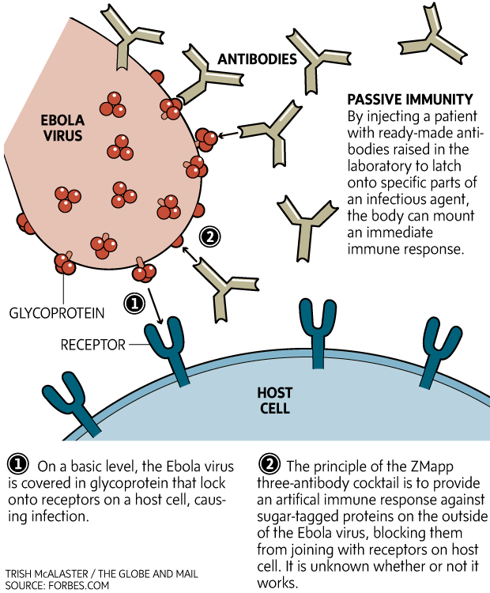
Monoclonal antibodies as therapy: ZMapp
Zmapp = cocktail of three antibodies targeting Ebola GP and sGP
2014 The Globe and Mail

Slide 9
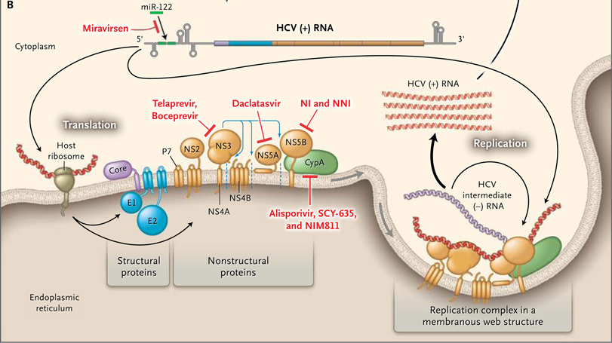
Nucleic acids as therapeutics
2013 Liang et. al NEJM

Slide 10
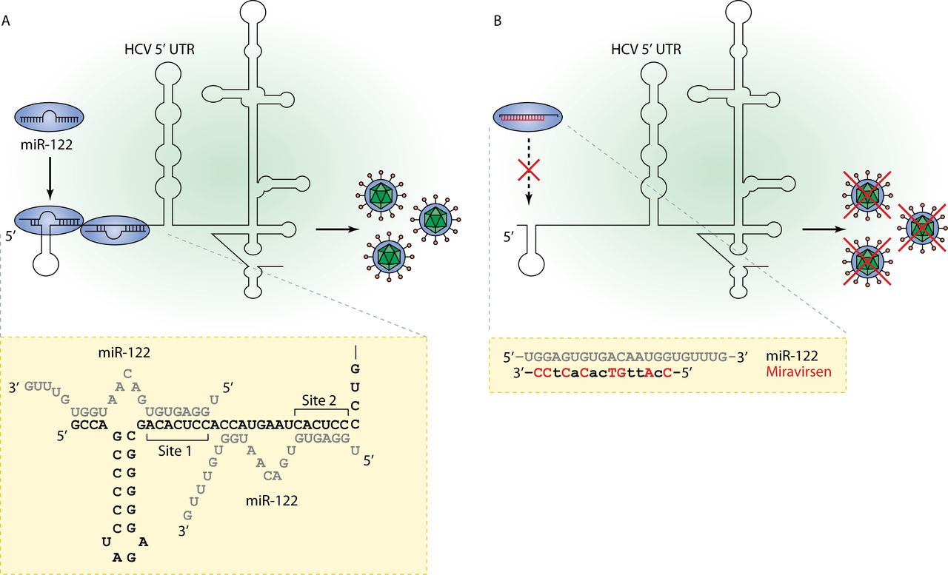
Nucleic acids as therapeutics
2012 Lindow et. al JCB

Slide 11
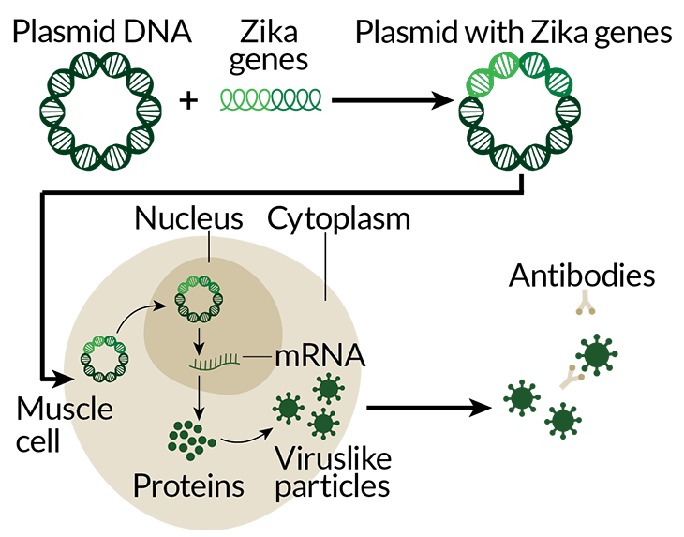
Nucleic acid-based vaccines
DNA (plasmid)-based approach
RNA-based approach
Technology amenable to rapid response with clean production
2017 Rosen Science News, 2017 Laura DeFranscesco Nature Biotech

Slide 12
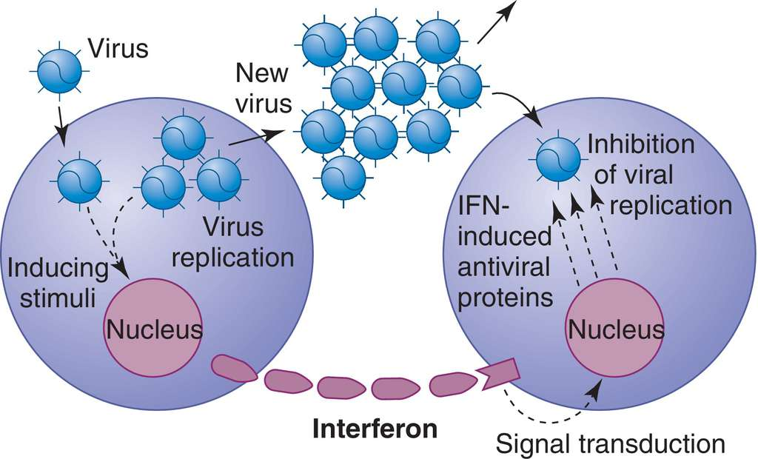
Protein-based therapeutics
Interferon (1957 Isaacs and Lindenmenn)
Mosby's Medical Dictionary, 9th edition. © 2009, Elsevier.

Slide 13
Broad-spectrum therapeutics against emerging pathogens…Coronavirus

Slide 14
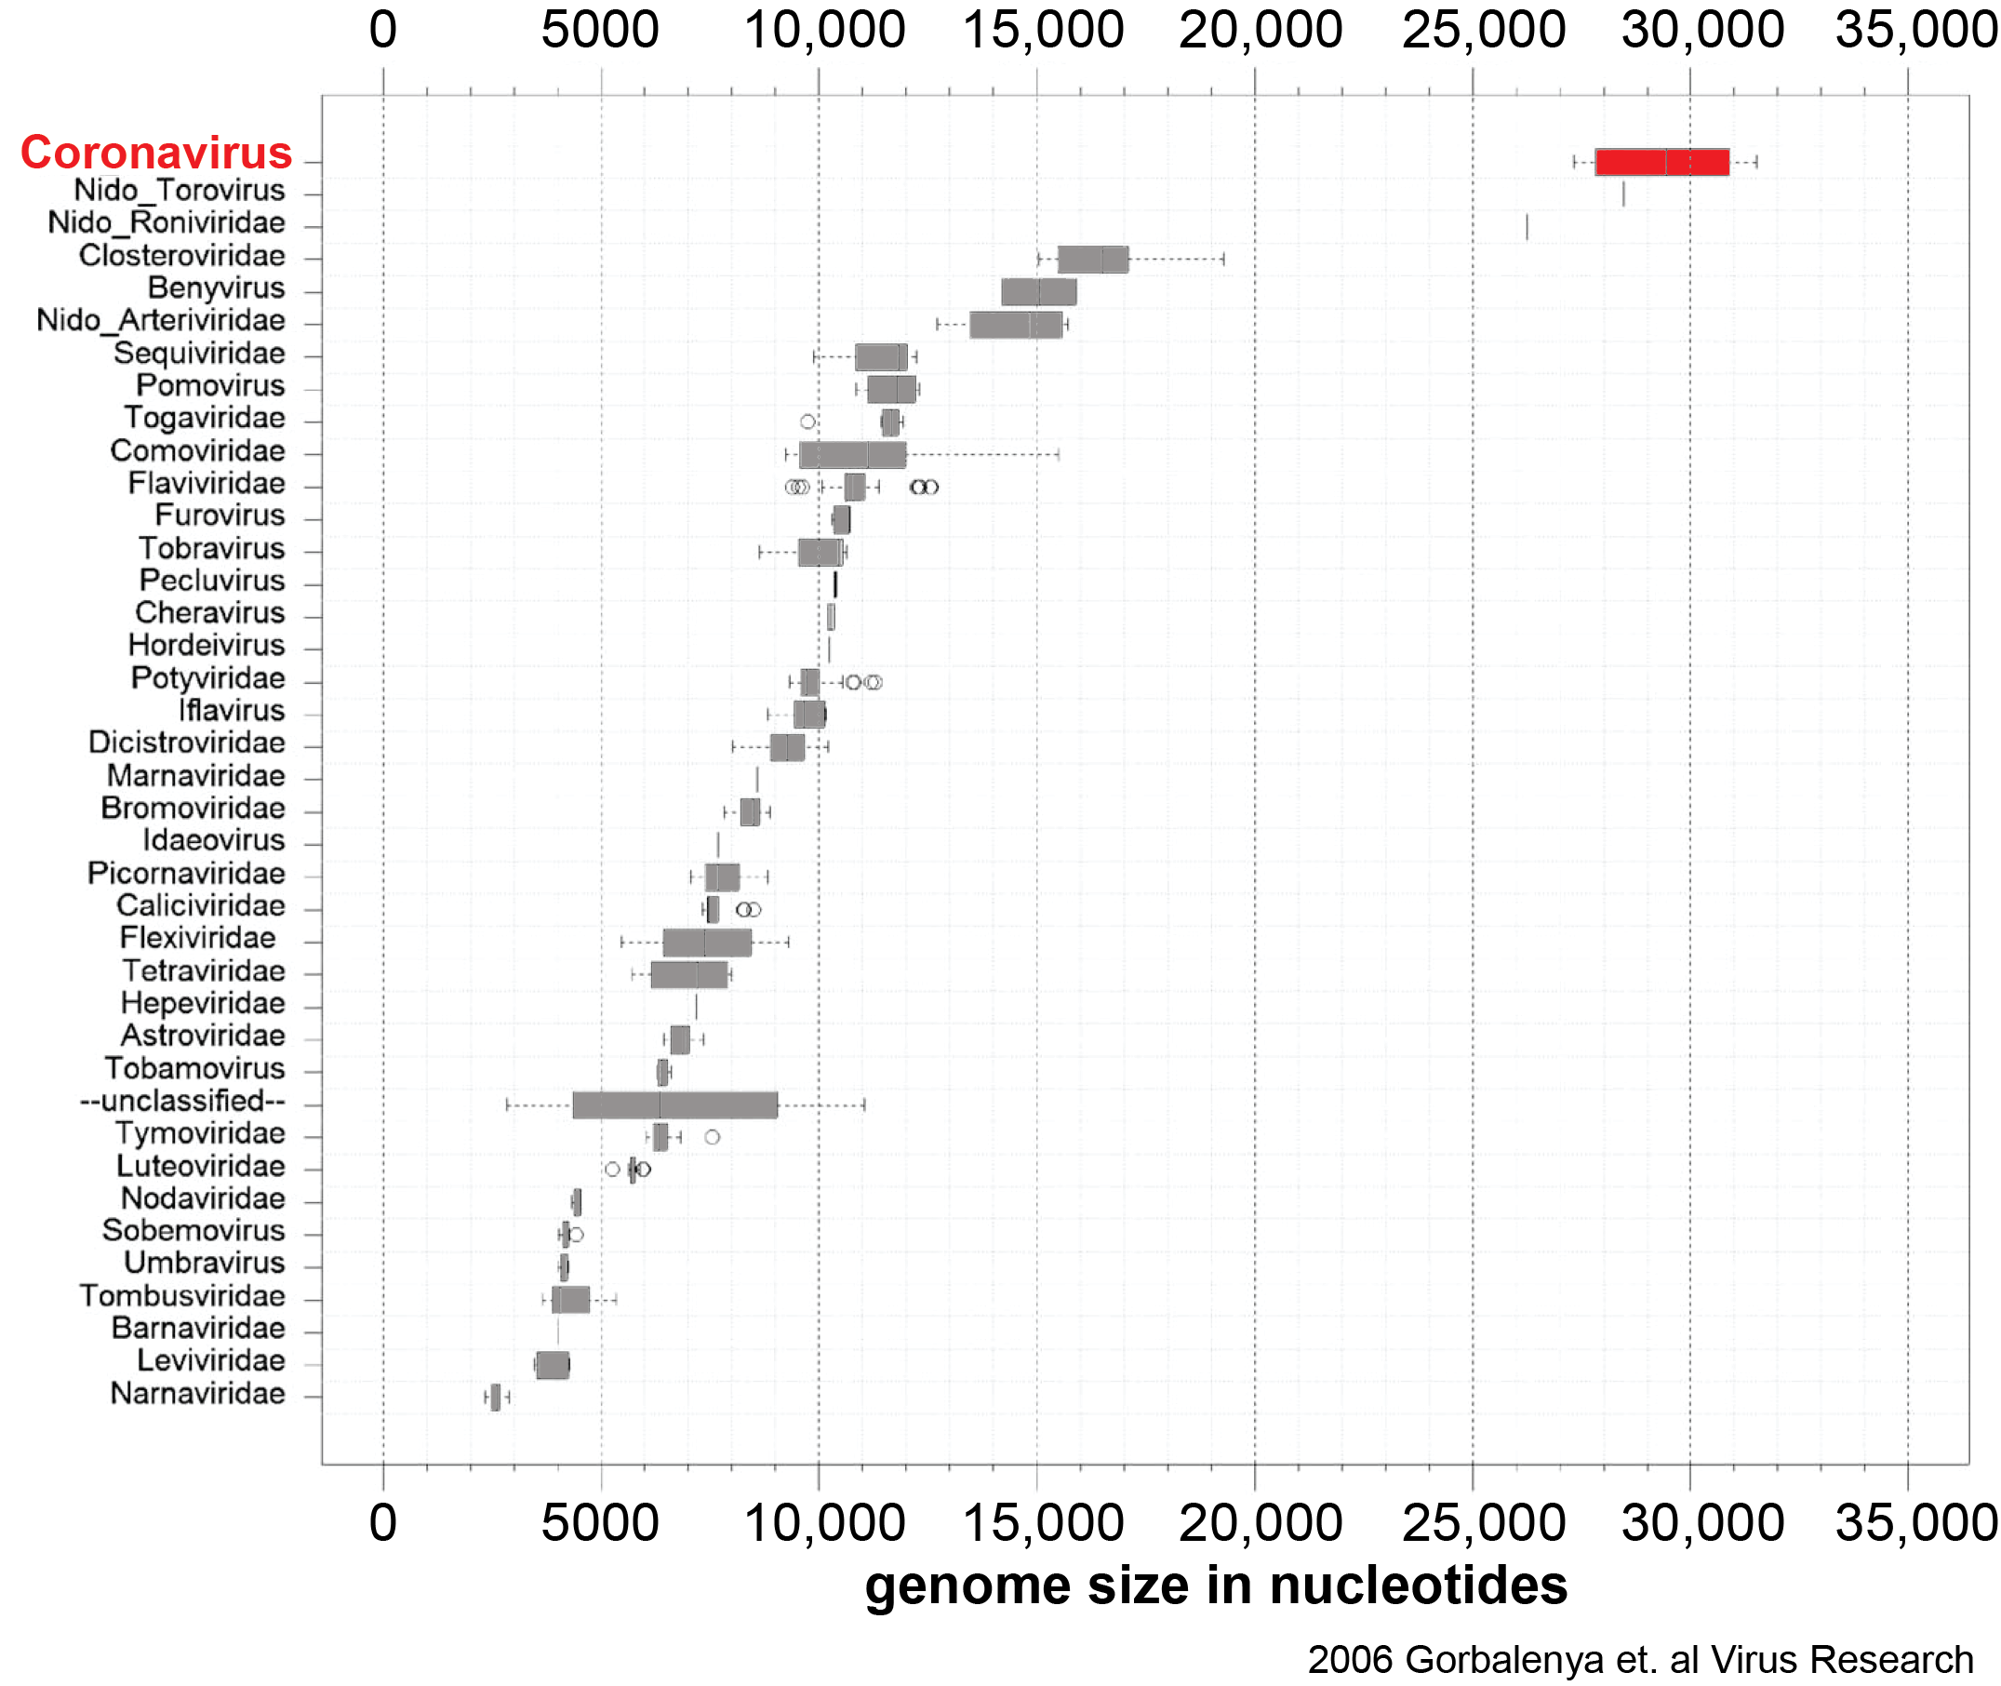
CoV are the largest RNA viruses

Slide 15
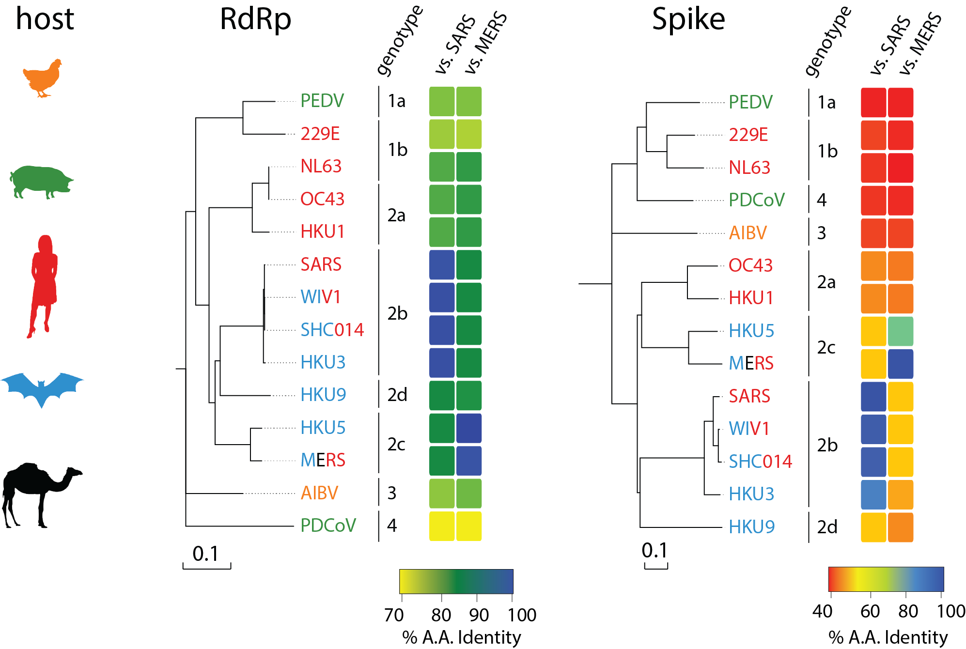
CoV are antigenically diverse

Slide 16
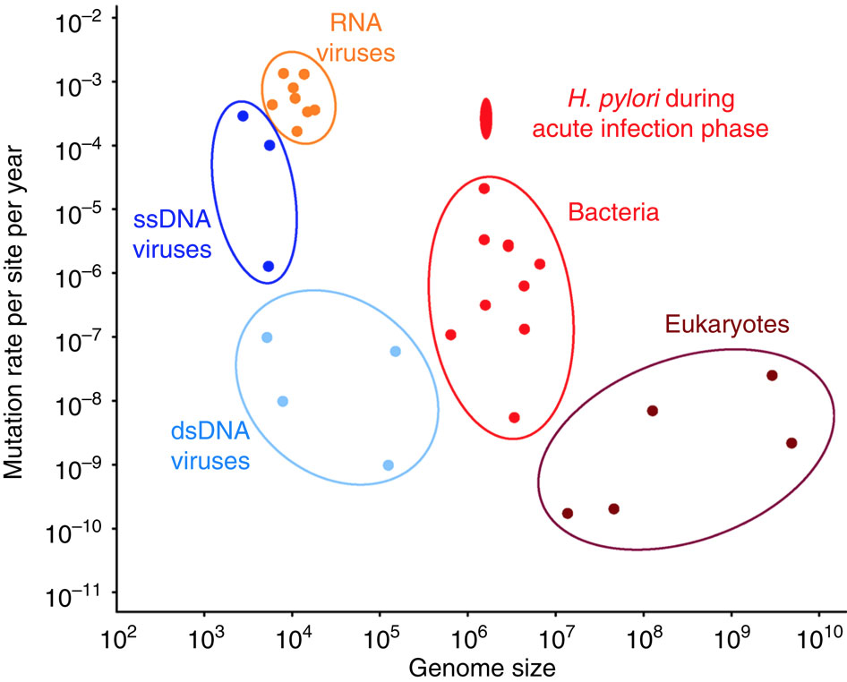
Mutation rates can promote rapid emergence
Mutation rates vary depending on genome size and composition
Coronavirus
Linz et. al. Nature Communications 2014

Slide 17
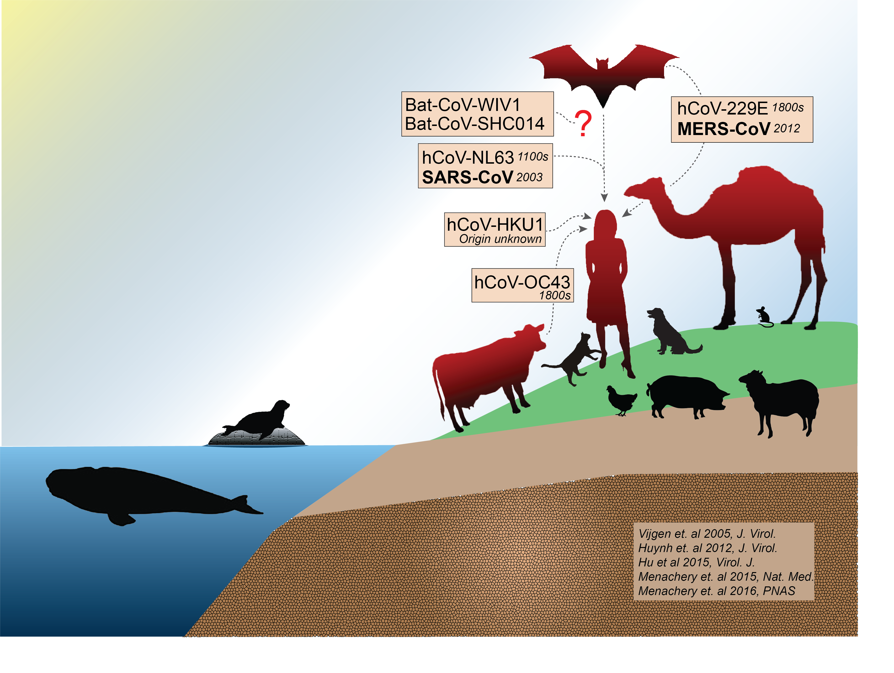
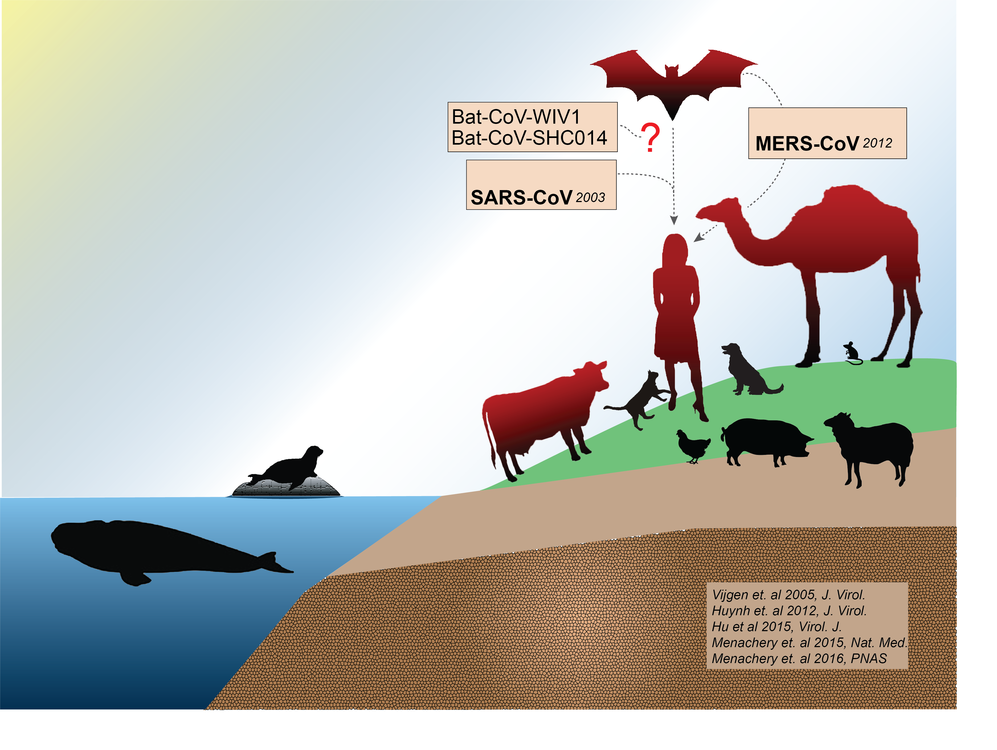
Coronavirus has emergence potential

Slide 18
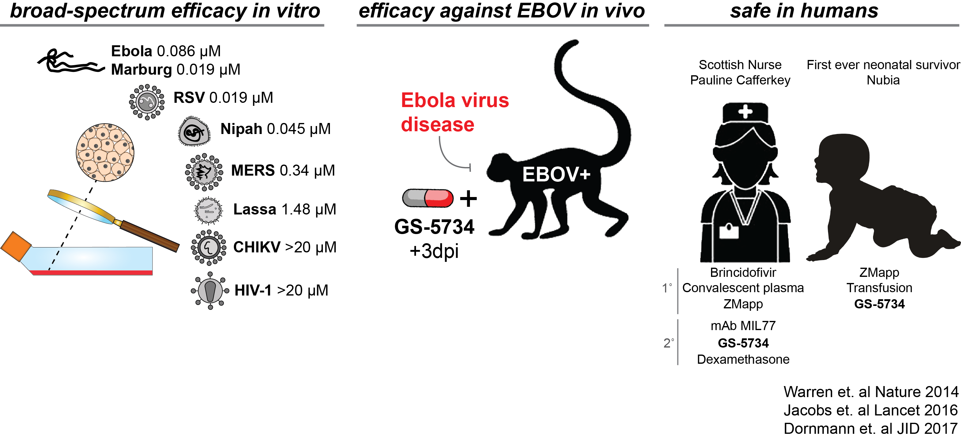
GS-5734 is a broad-spectrum antiviral

Slide 19
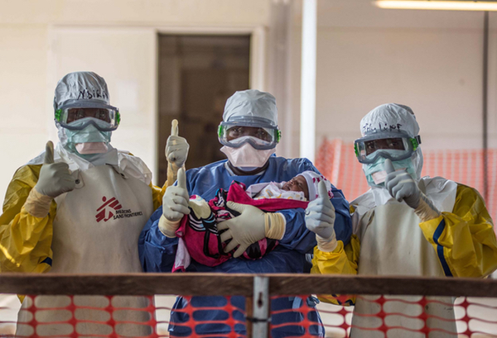
Nubia: First ever neonate to survive Ebola
Photo from MSF

Slide 20
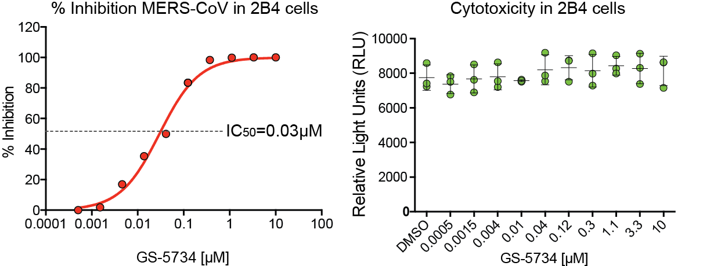
GS-5734 is antiviral against MERS-CoV
Sheahan et. al 2017 Science Translational Medicine
Notes:
Selectivity index >400

Slide 21
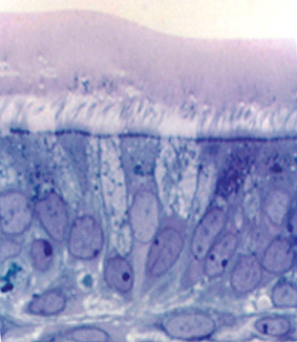
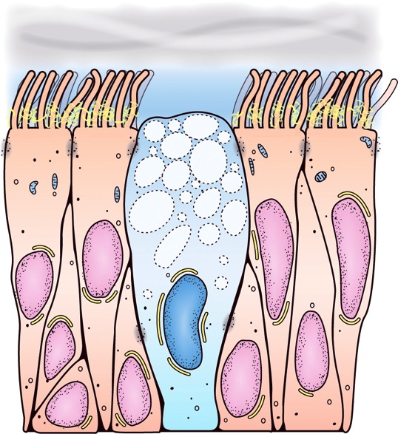
Modeling the human airway with HAE
Mucus Layer
Cilia
Tight Junctions
Goblet cells
Human Airway Epithelial (HAE) Cell Cultures differentiate at air:liquid interface from basal cells over 3 to 6 weeks

Slide 22
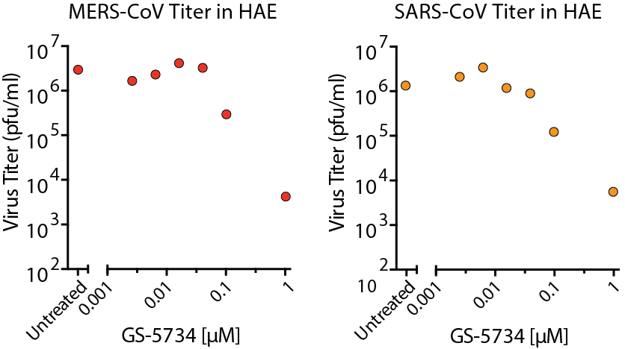
GS-5734 is antiviral in primary human cells
IC₅₀ = 0.074µM
IC₅₀ = 0.069µM
Performed by Dr. Amy Sims
Sheahan et. al 2017 Science Translational Medicine
Notes:
Selectivity index >100

Slide 23
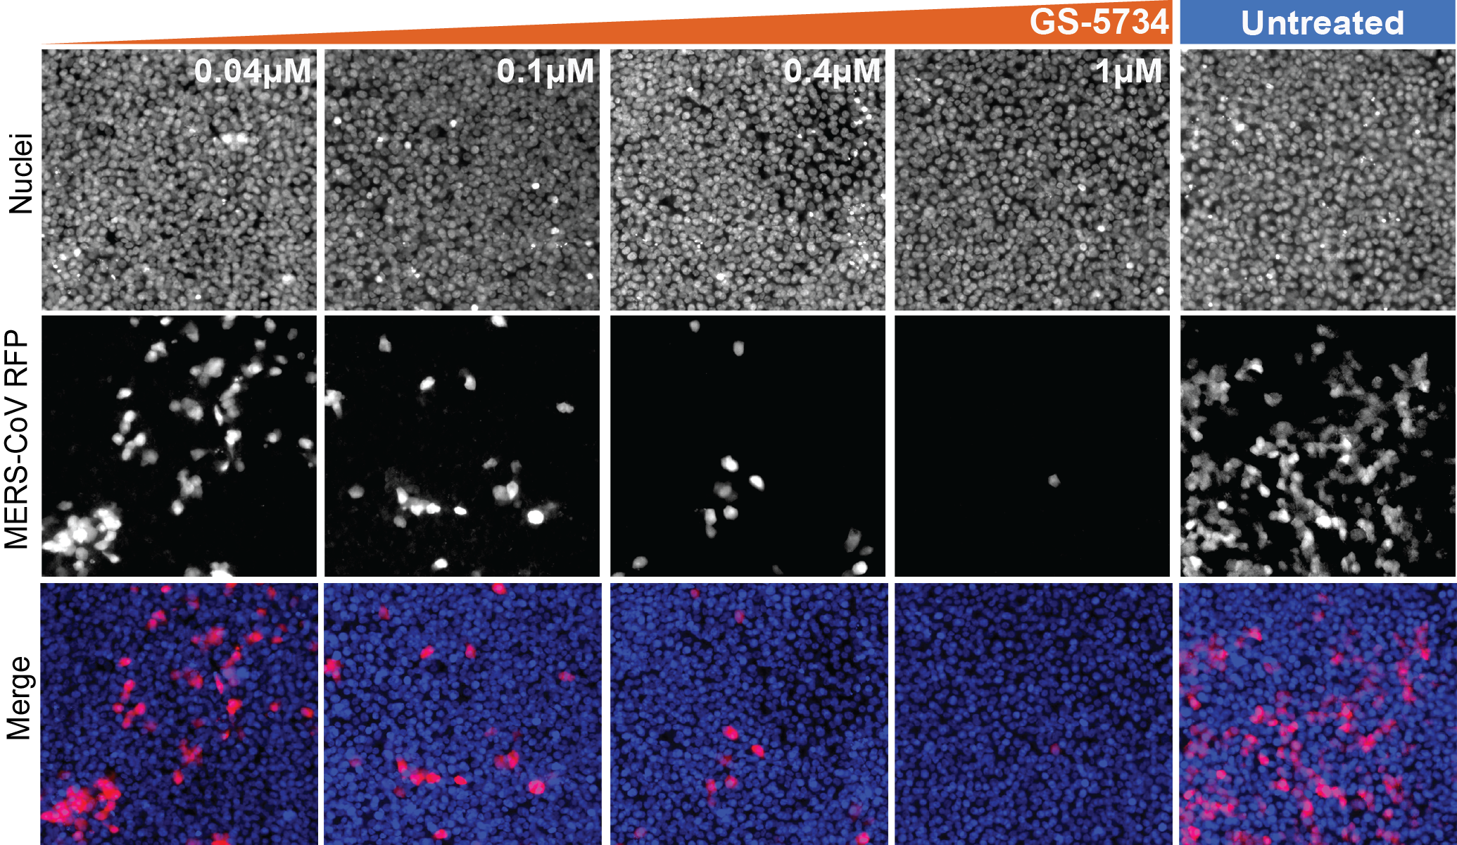
GS-5734 is antiviral against MERS-CoV
Performed by Dr. Amy Sims
Sheahan et. al 2017 Science Translational Medicine

Slide 24
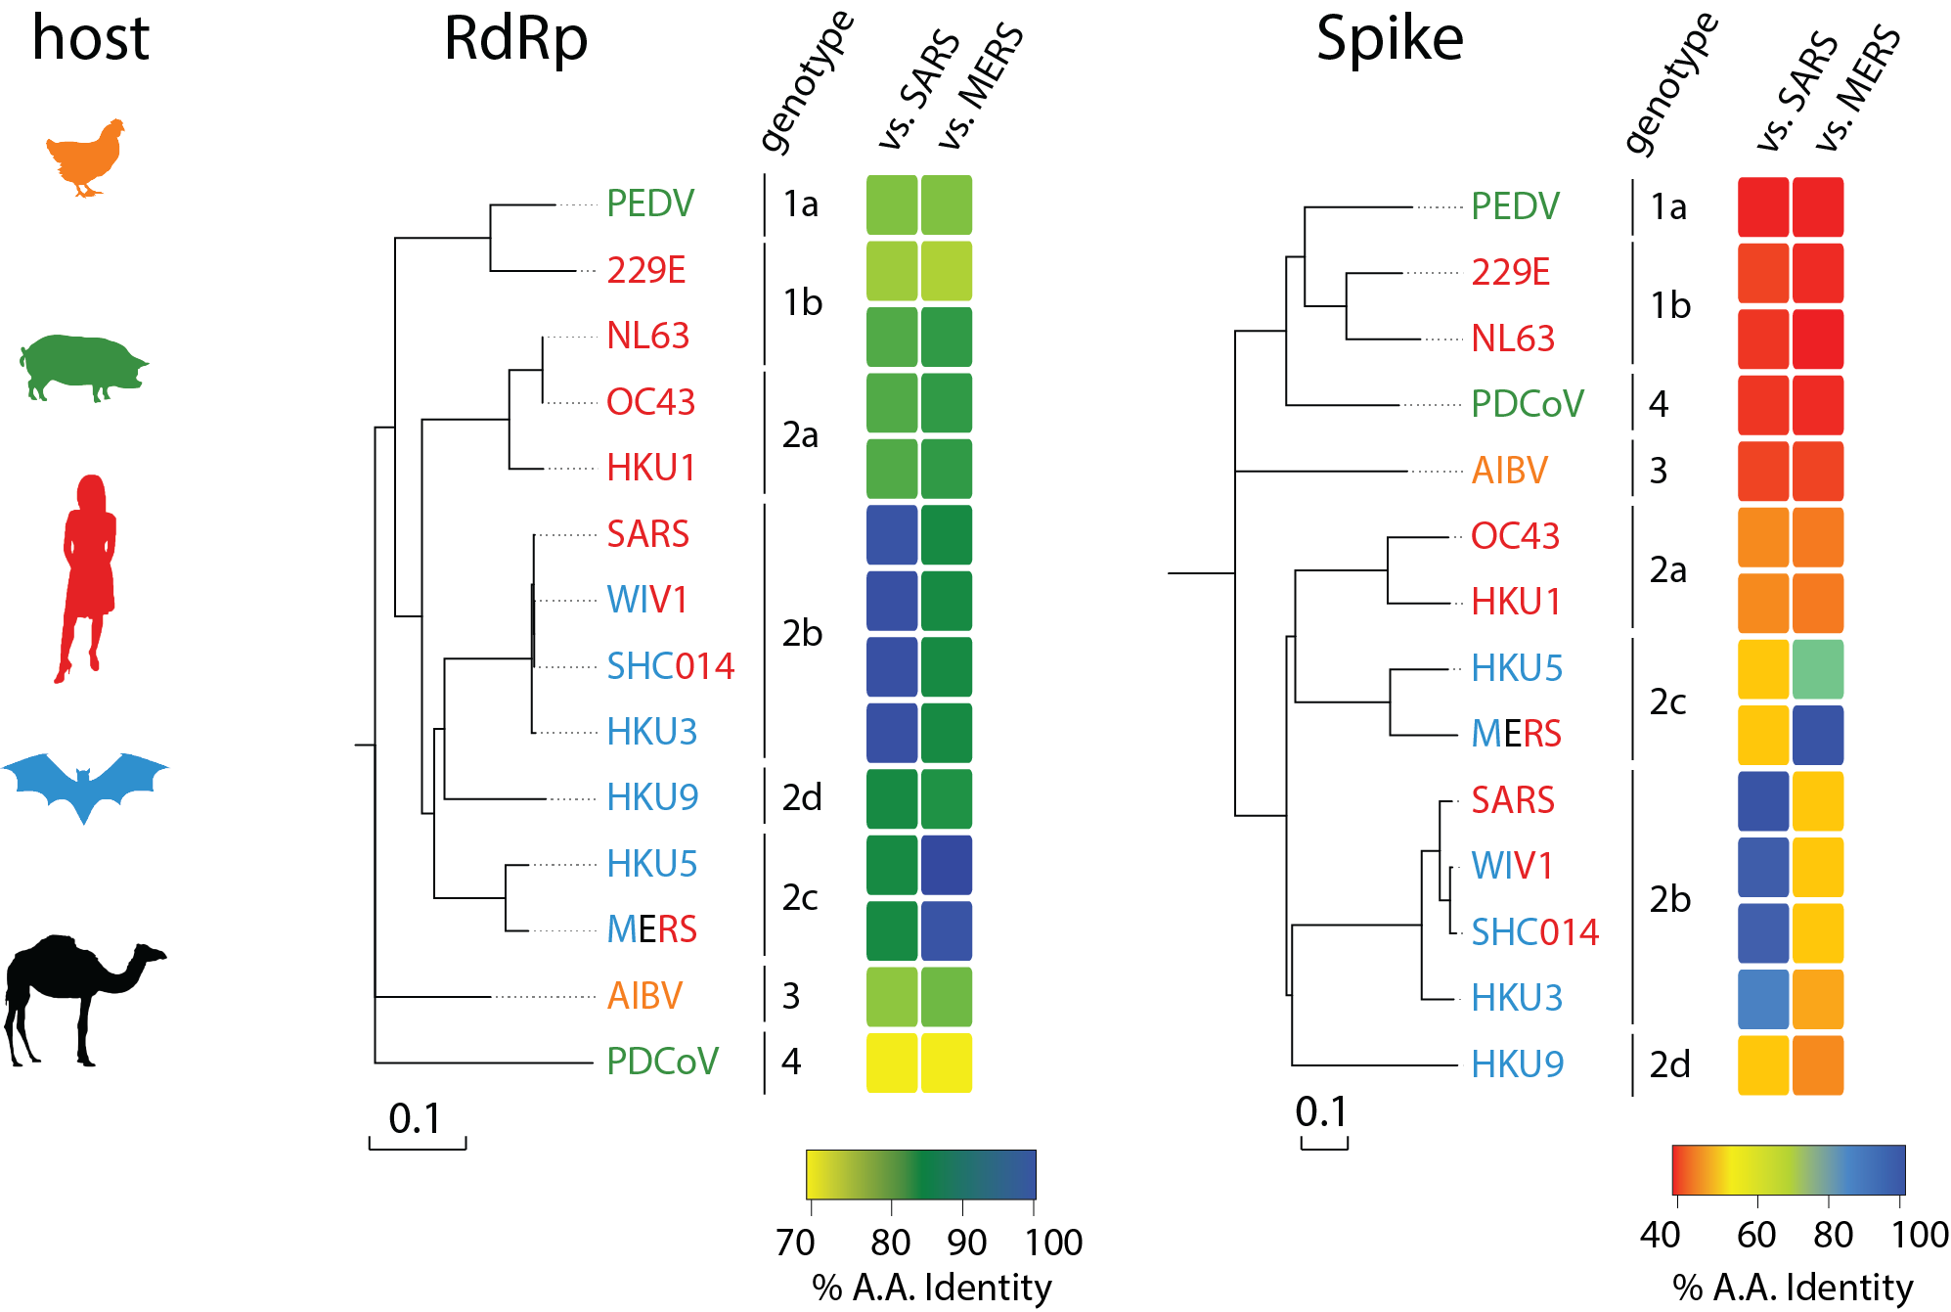
Is GS-5734 broad-spectrum for CoV?
Dr. Rachel Graham
Sheahan et. al 2017 Science Translational Medicine

Slide 25
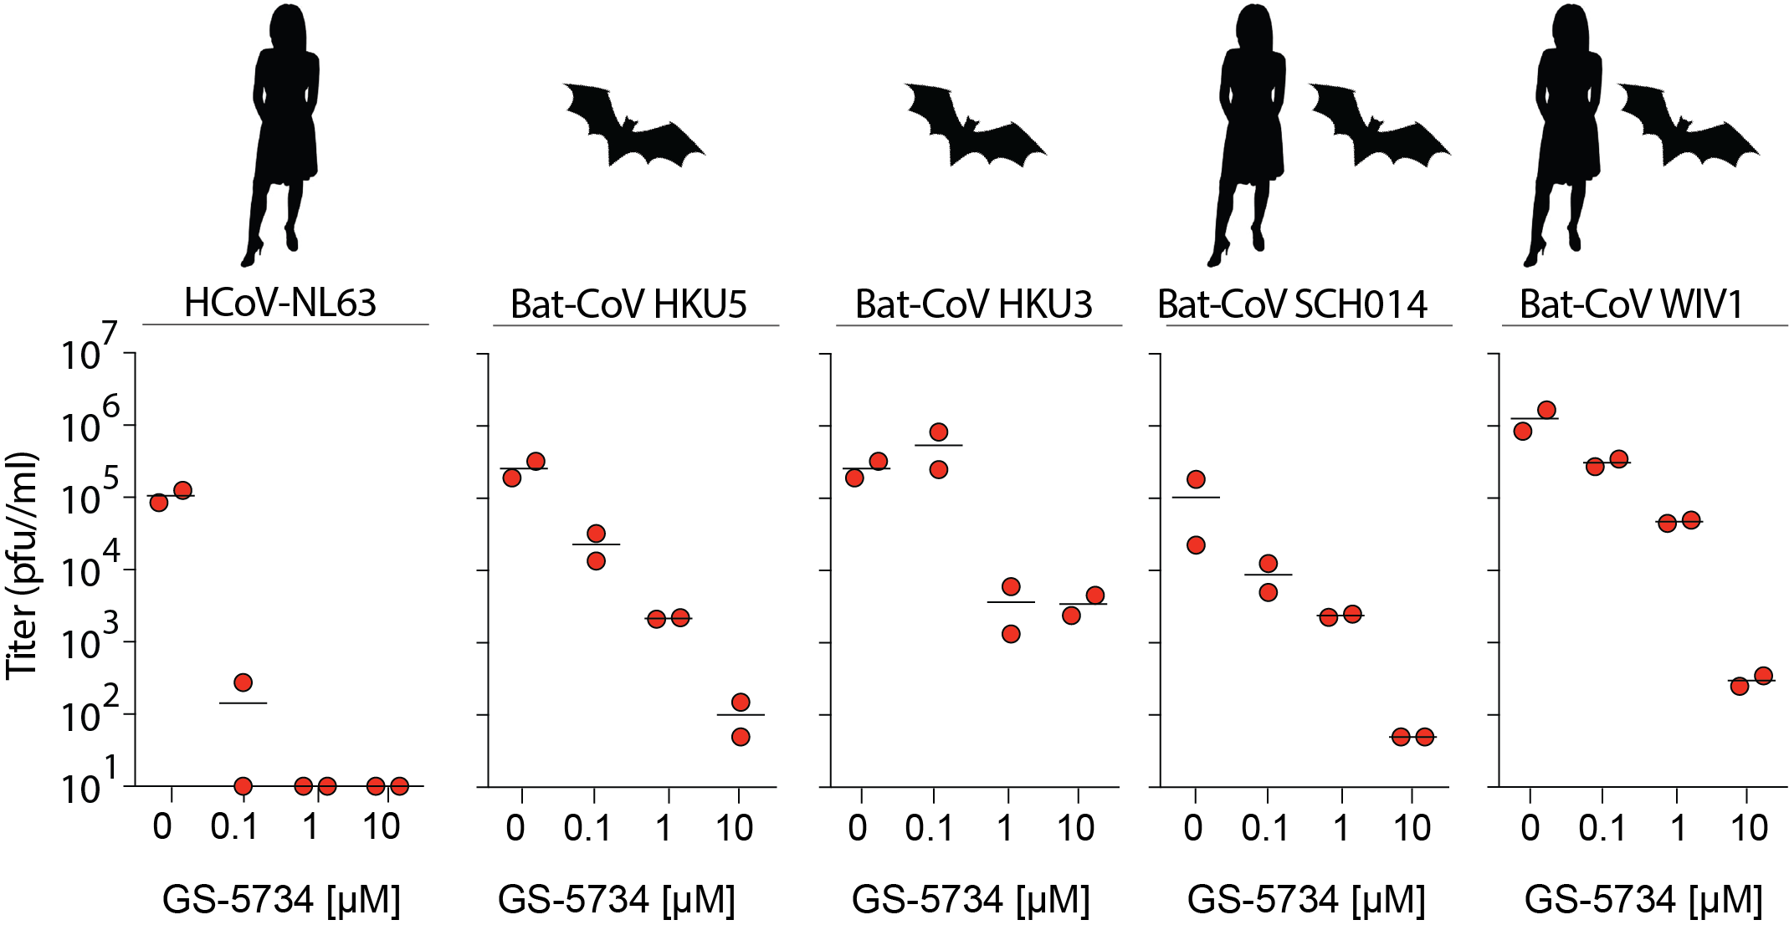
Efficacy of GS-5734 against diverse CoV
Performed by Dr. Amy Sims
Sheahan et. al 2017 Science Translational Medicine

Slide 26
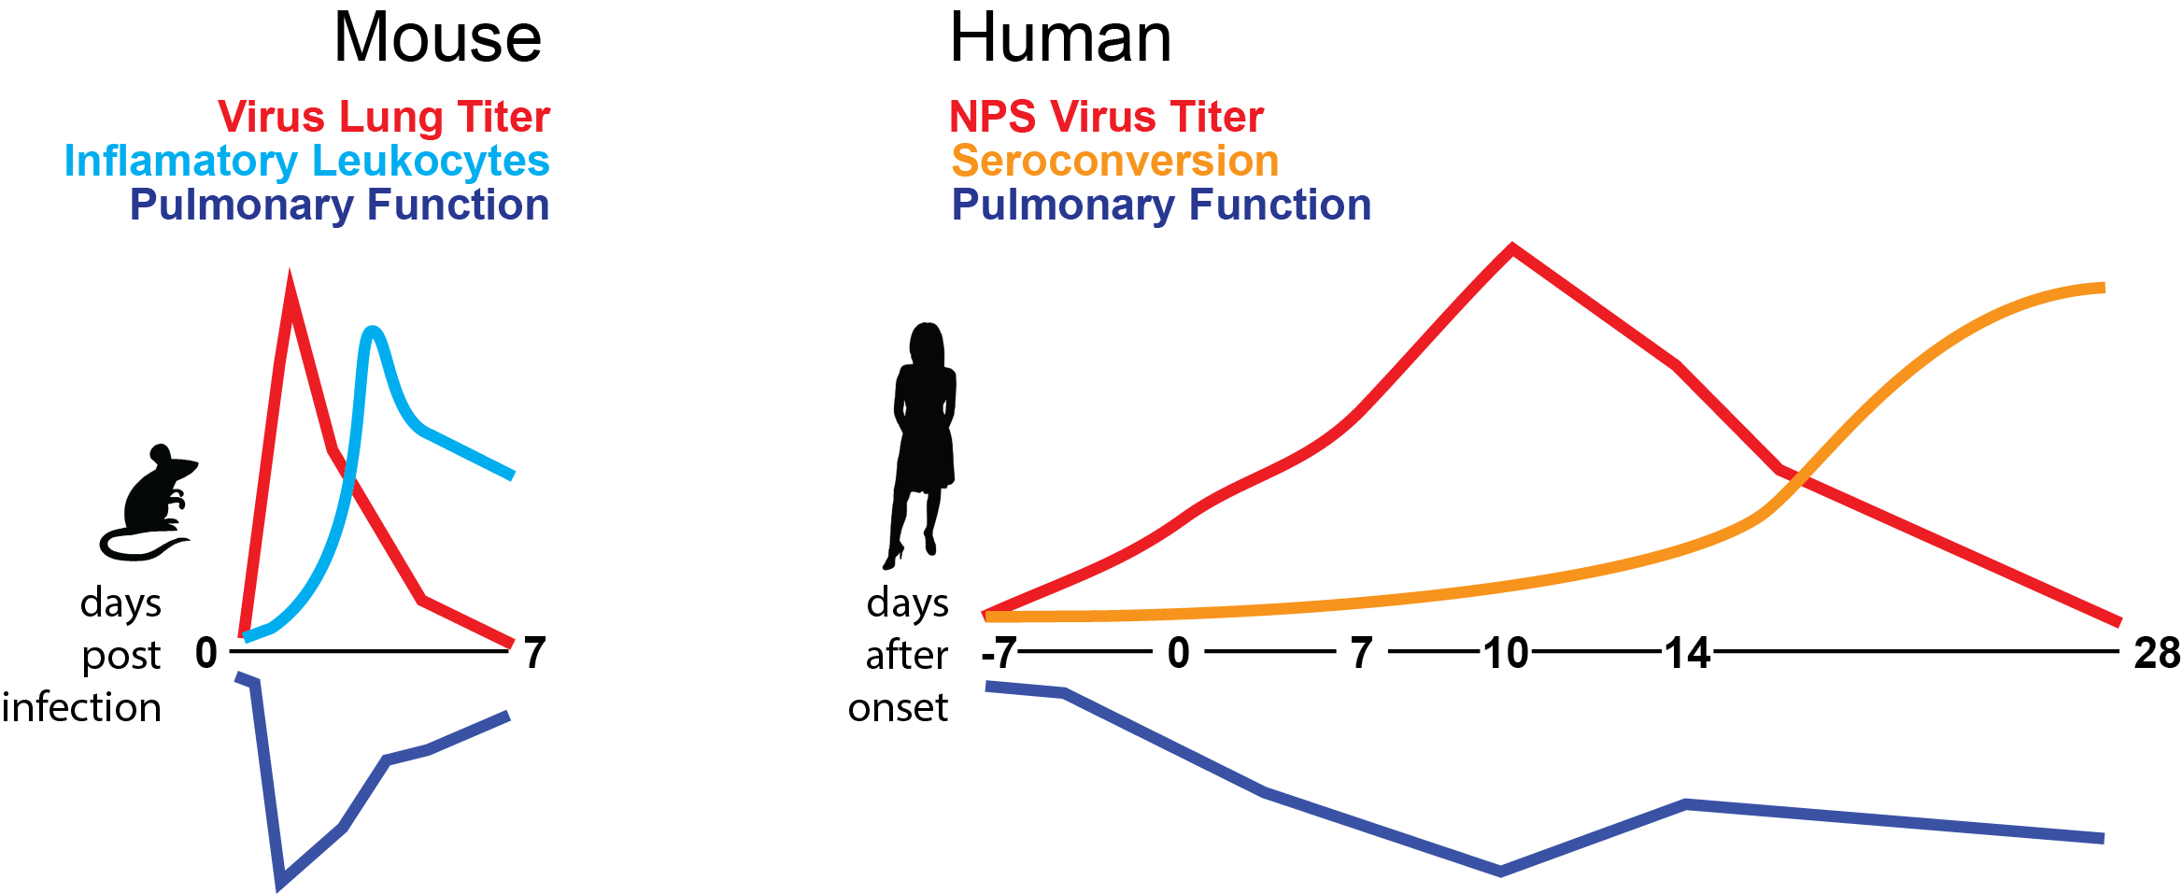
CoV disease kinetics compressed in mice

Slide 27
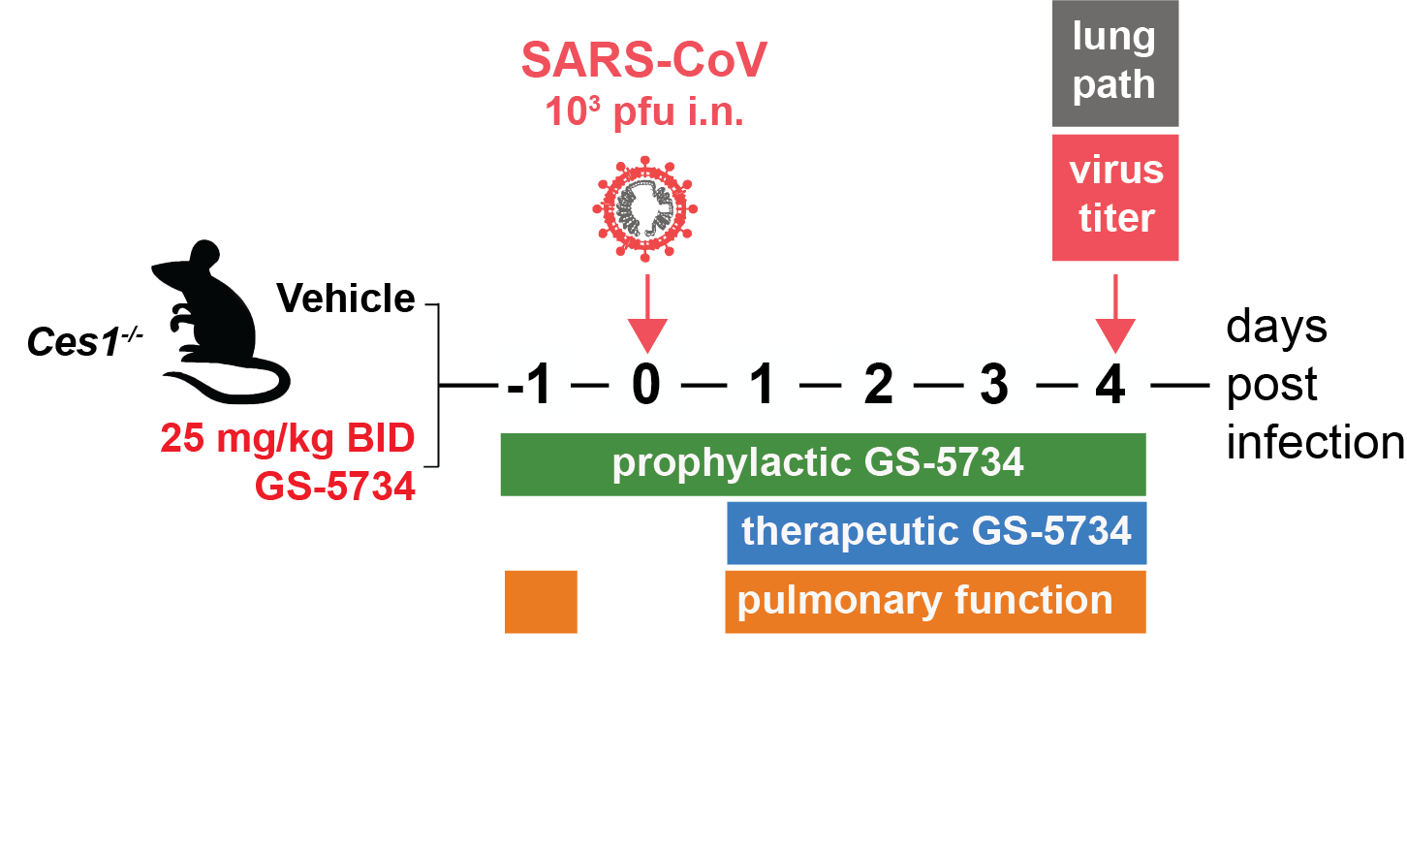
Will GS-5734 work in vivo?

Slide 28
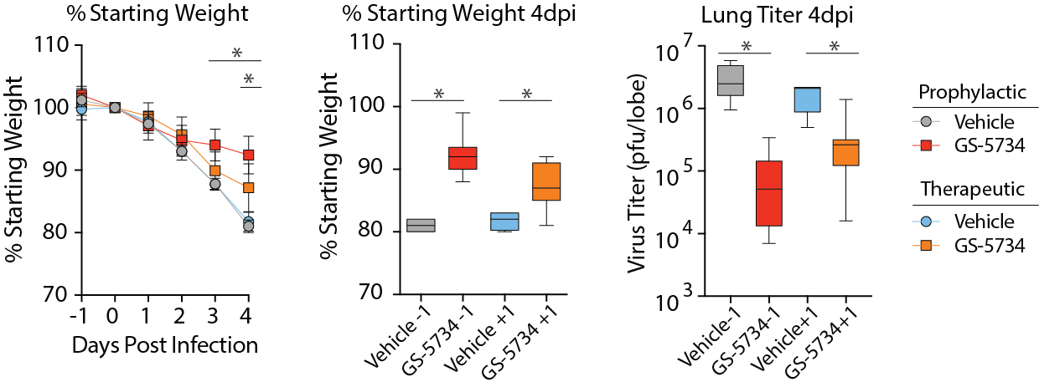
GS-5734 diminishes SARS-CoV disease
Sheahan et. al 2017 Science Translational Medicine

Slide 29
GS-5734 diminishes SARS-CoV disease
Sheahan et. al 2017 Science Translational Medicine

Slide 30
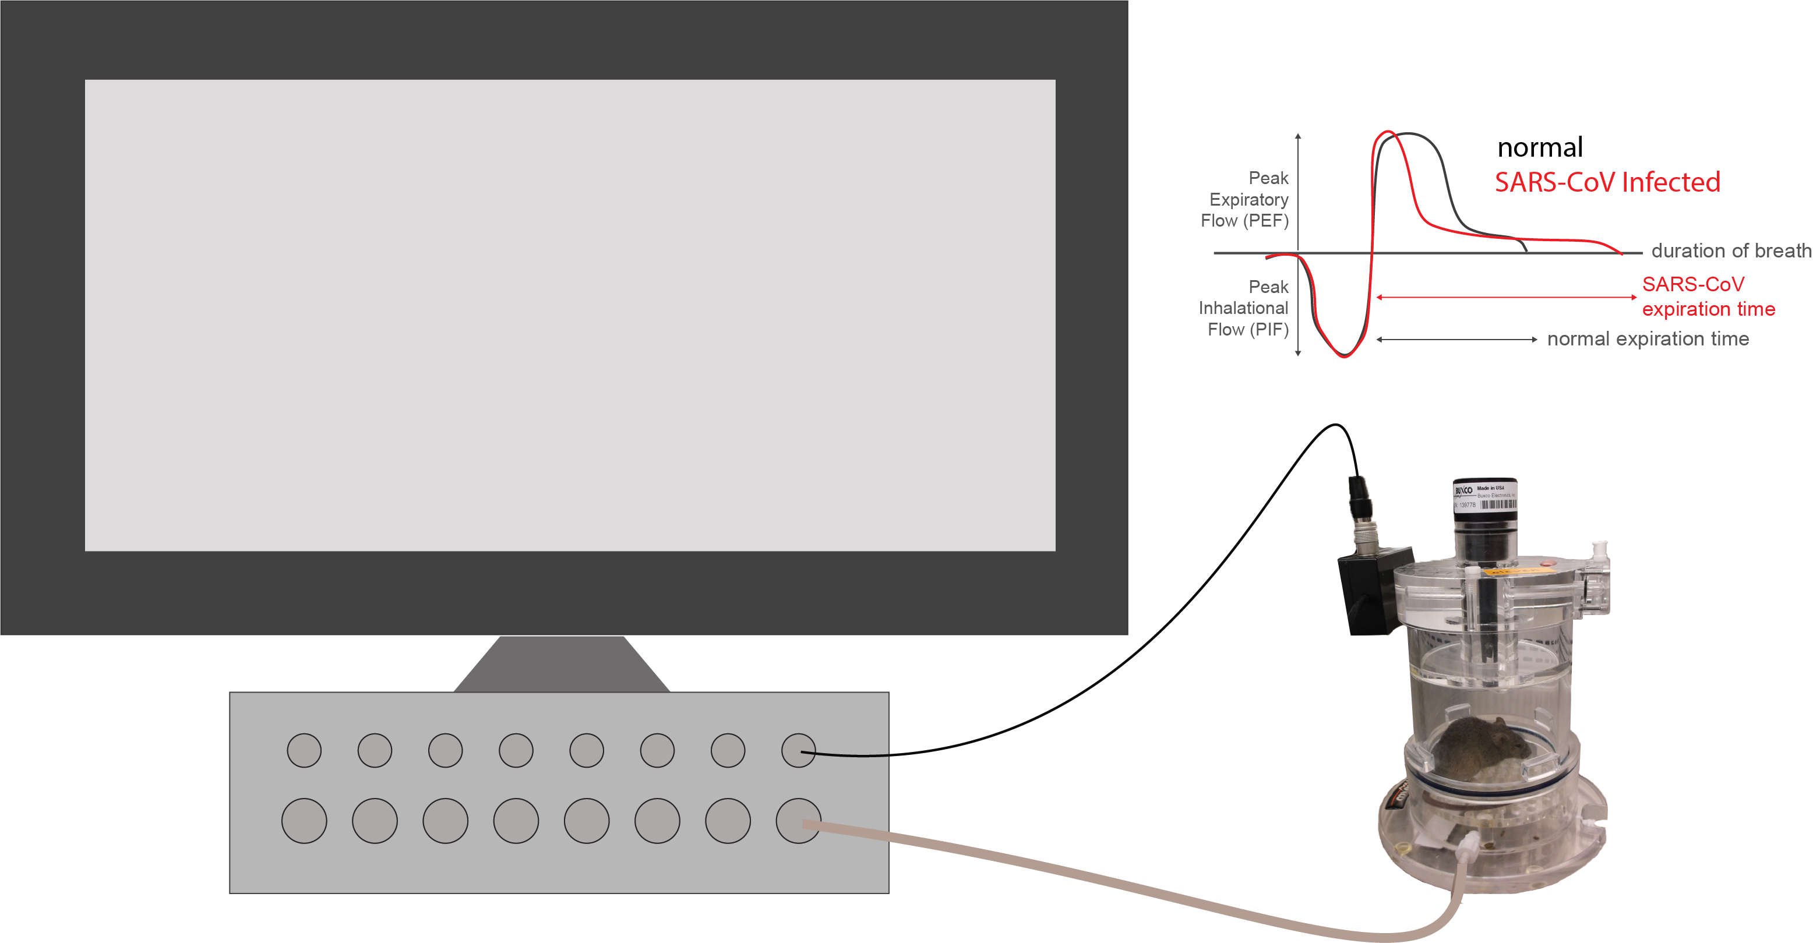
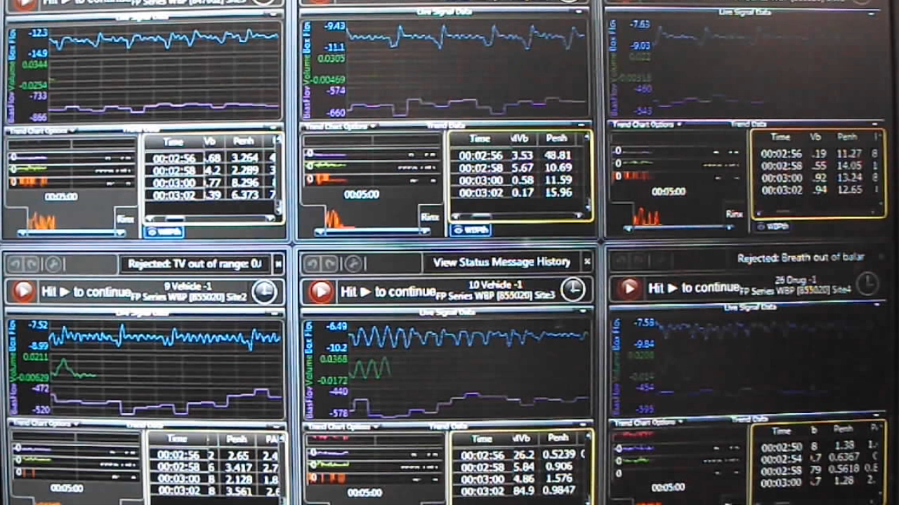
Lung function by whole-body plethysmography
Notes:
30 min acclimation time.
Measure every 2 seconds for 5 min = 150 data points for 11 metrics

Slide 31
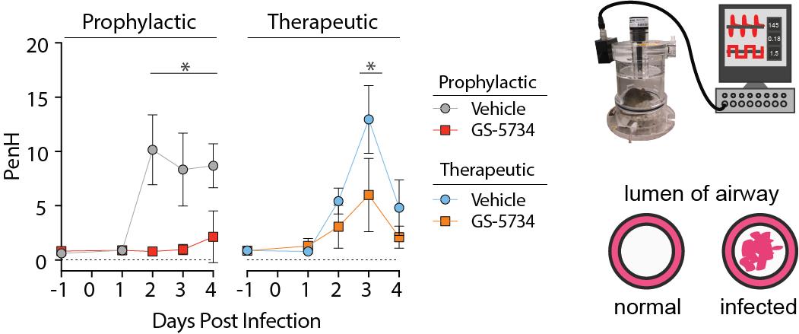
GS-5734 improves pulmonary function
Sheahan et. al 2017 Science Translational Medicine

Slide 32
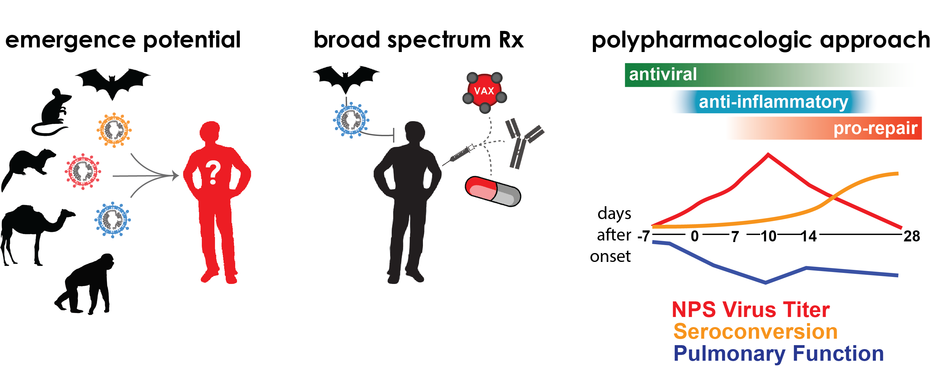
Pandemic preparedness with broad-spectrum CoV therapeutics

